Slide 1
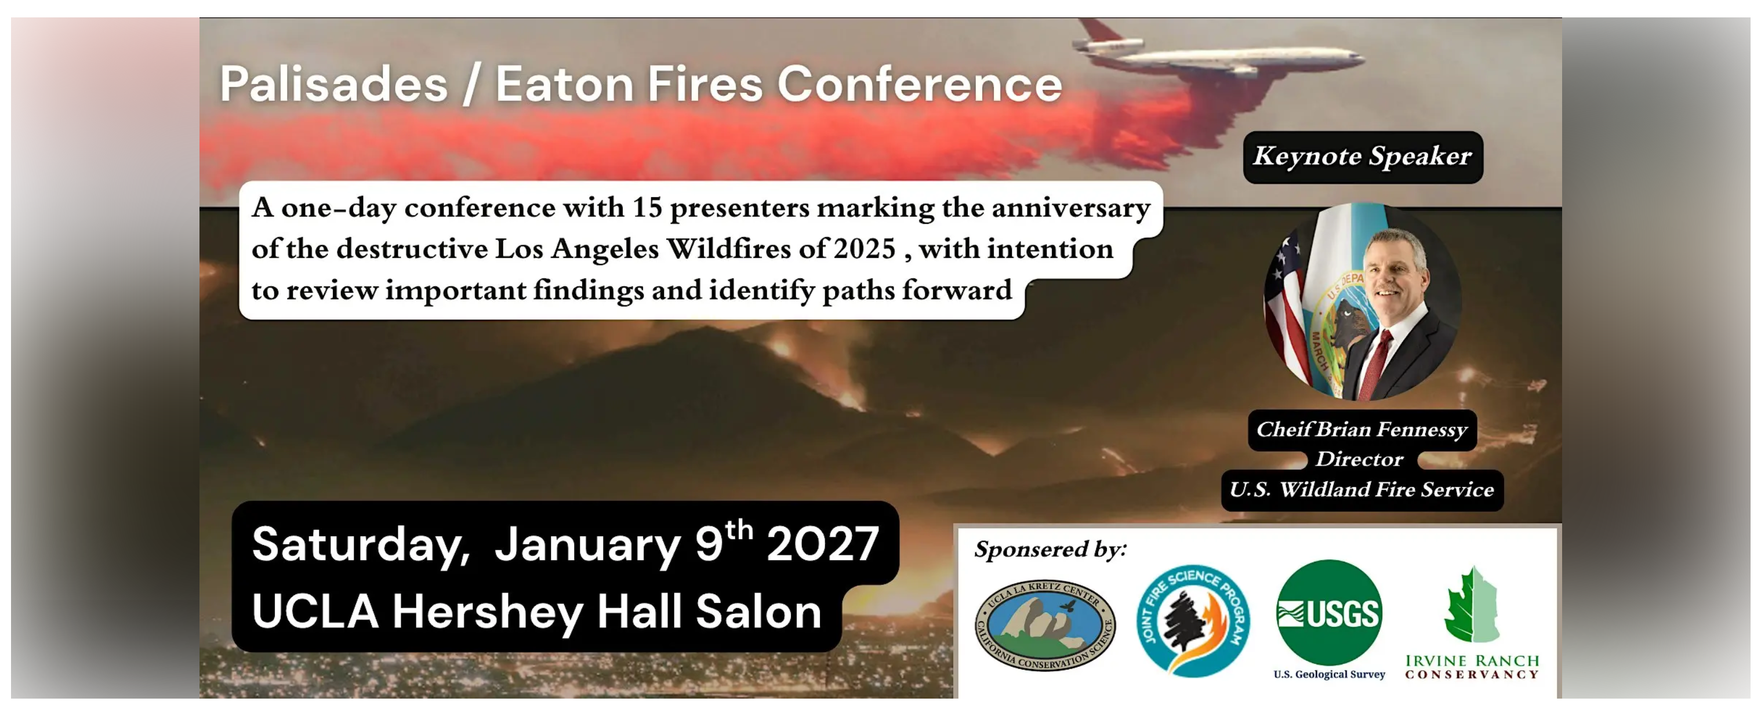
Reserve @ https://www.eventbrite.com/e/palisades-eaton-fires-conference-tickets-2003270643421?aff=oddtdtcreator

